Slide 1
Computer Engineering 12 Class 2
Instructor: Yuhong Liu
Office: Banan 324 F
Email: yhliu@scu.edu
Tel: 408-551-3513

Slide 2
Review – Data Structure
What is a data structure?
How data is organized in memory(or hard disk)
Why do we care data structure?
Efficiency - time/space efficiency
How to measure time efficiency?
Count # of operations.
What types of operations do we care?
Insertion
Deletion
Access/Search
Min/max
Union/merge …
When do we care?
We only care the one with the highest impact on efficiency

Slide 3
Review – Big-O Notation
The correct form of big-O
Drop all but the fastest-growing term
Drop the constant coefficient of the remaining term
E.g. 1500n^2 +4n + 3logn + 2
How to evaluate the big-O for a piece of code?
We mainly care repetitive operations
operations that are only executed once (or constant times) will be ignored
Loops
Single layer loop
Nested loop

Slide 4
Nested Loop I - Independent Loops
for(i=0; i<n; i++)
for(j=0; j<n; j++)
x++;
?
Notes:
O(n^2)

Slide 5
Nested Loop II -Dependent Loops
for(i=1; i<=n; i++)
for(j=1; j<i; j++) x++;
Previous loops independent, this is .... “dependent” (good guess)
j loop runs: 0+1 + 2 + 3 + ... + n-1
n(n-1)/2 which is O(n^2)
Gauss was in kindergarten, asked to sum numbers from 1 to 100. Write it forwards 1 ... n, then backwards underneath. Each column adds to n+1 ... n times. But you added twice, so the closed form is n(n+1)/2
There are better proofs ... e.g., proofs by induction in discrete maths

Slide 6
Nested Loop II -Dependent Loops
for(i=0; i<n; i=i+2)
for(j=i; j<n; j++) x++;
Notes:
O(n^2)

Slide 7
Summary: Big-O for Nested Loops
Step 1: analyze if it’s dependent loop or independent loop
assume the counter variable of the outsider loop is i
(1) if i is not involved in insider loop => independent loop
(2) otherwise => dependent loop
Step 2:
If independent loop:
O_overall = O(outsider loop) * O(insider loop)
Else (dependent loop):
For each iteration of the outsider loop => count # of operations for the insider loop
add them together

Slide 8
More Big-O Examples
for(i=0; i<n; i=i+n) easy
x++;
Notes:
O(1)

Slide 9
More Big-O Examples
for(i=1; i<n; i=i*3) easy
x++;
Notes:
O(log n)

Slide 10
More Big-O Examples
for (i = 0; i<n; i = i+3) easy
f()
where f() is O(n^2)

Slide 11
More Big-O Examples
for (i=0; i<n; i++) not too hard
g()
for (j= 0; j <n; j++)
x++;
where g() is O(logn)

Slide 12
More Big-O Examples
for(i=n; i>=1; i=i/3) not too hard
for(j=0; j<n; j++) x++;
Notes:
Independent loops, so we can analyze separately and multiply together
O(log n) x O(n) = O(n log n)

Slide 13
More Big-O Examples
for(i=1; i<=n; i=i*2)
for(j=1; j<=n; j=j+i) x++;

Slide 14
for(i=1; i<=n; i=i*2)
for(j=1; j<=n; j=j+i) x++;
Dependent.
n + n/2 + n/4 + n/8 ... = n(1+1/2+1/4+ ...)
Geometric series: 1+ alpha + alpha^2 +…. = 1/(1-alpha)
O(n) ... i.e., two loops does not mean it has to be n^2 or n log n ... this is more challenging than a midterm question
Challenge: replace i*2 by i++ and see what happens!
Good news: too hard for the exam!

Slide 15
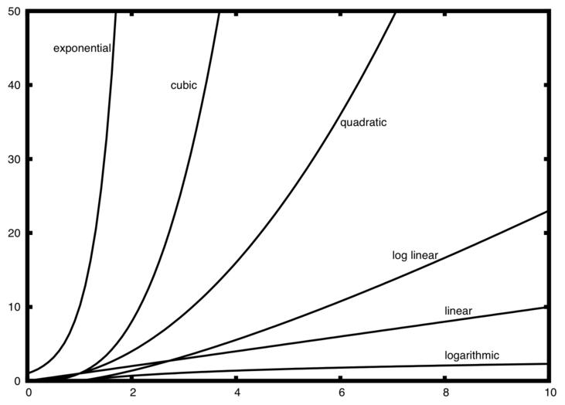
Common Big-O Complexity Classes
Constant O(1)
Logarithmic O(logn)
why don’t we care about the base
of the log?
Linear O(n)
Log-Linear O(n logn)
Quadratic O(n^2)
Cubic O(n^3)
Polynomial O(n^k)
Exponential O(2^n) or O(k^n)
Factorial O(n!)
not pronounced <shout>“N!”</shout>
Anything worse than Exponential (actually, even quadratic) are considered pretty bad.
Check textbook P34 Figure 1-14 for more details
Exam Hint!

Slide 16
So far …
We have discussed contents in Chapter 1
Concept of data Structure
Algorithm Efficiency – big O notation

